Slide 1

JOB ANALYTICS PROJECT
ON LINKEDIN

Slide 2

Group Members
Shashank Shukla
Saahil Khan
Saurav Labade
Abhishek Anand .

Slide 3

Steps:
We scrap the data from the professional networking site LinkedIn, using the python library , BeautifulSoup (or similar) and make 3 tables using the data.
And we then collate the information into 3 tables using the data.
1) Jobs
2)Company
3)Involvement .

Slide 4
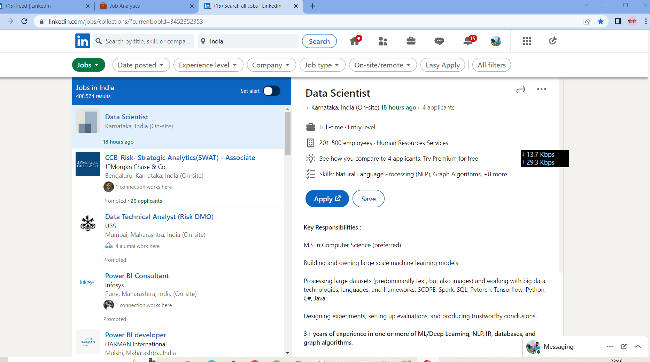

Slide 5
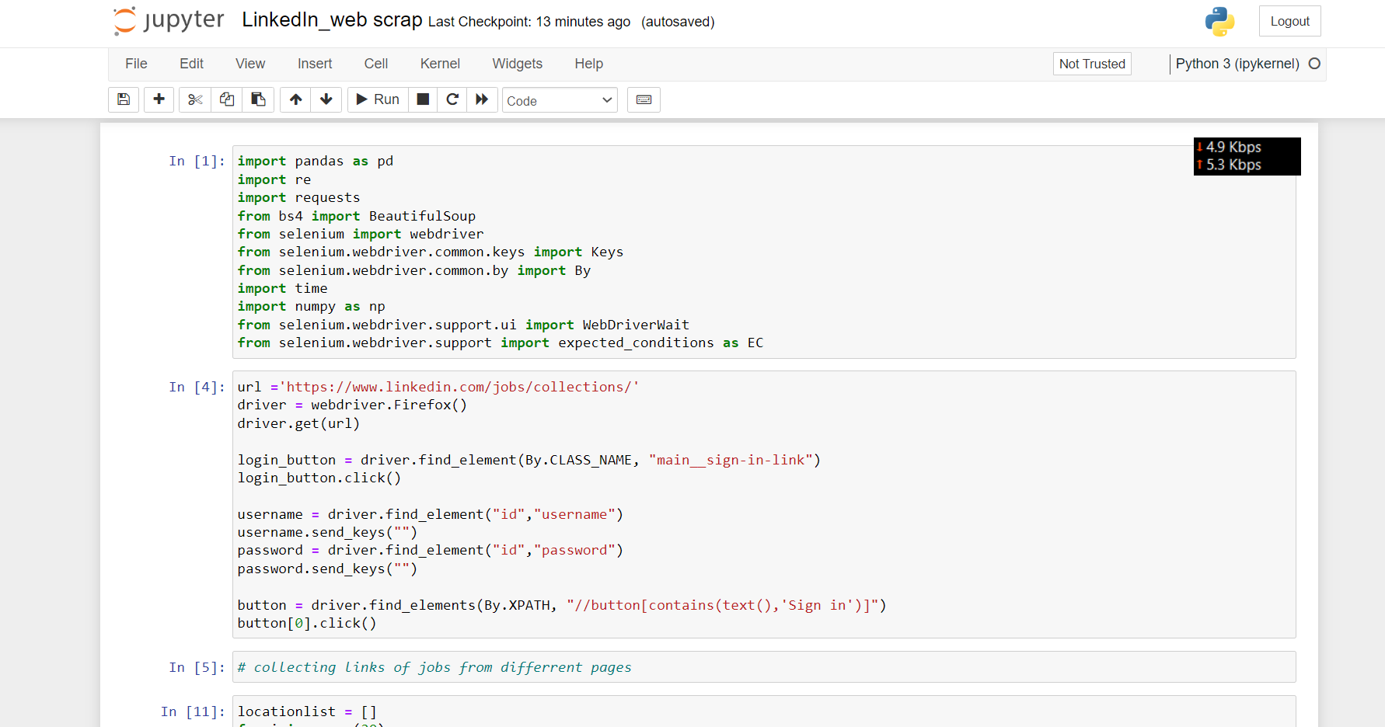

Slide 6
Tables :
Jobs
Job Id
Company Id
Location
Designation
Details_id
Company
Company_Id
Company_Name
Industry
Number_of_employees
Details
Details_id
Involment
Level
Total_Applicants

Slide 7
Goal

